Slide 1
The Entity-Relationship Model
courtesy of Joe Hellerstein for some slides

Slide 2
The Entity-Relationship Model ⎯ Toward a Unified View of Data
By Peter Pin-Shan Chen.
  In ACM Transaction on Database Systems (TODS), Vol. 1 (1), 1976.
Also by Peter, a retrospect of ER
  Entity-Relationship Modeling: Historical Events, Future Trends, and Lessons Learned

Slide 3
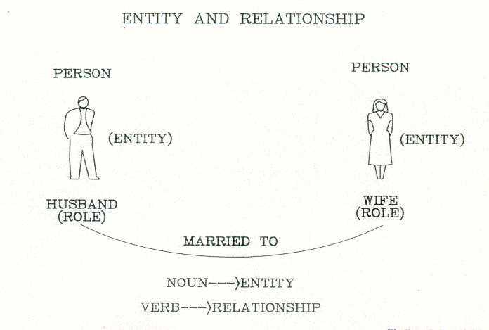
Concept of Entity and Relationship: from the retrospect

Slide 4
Steps in Database Design
Requirements Analysis
  user needs; what must database do?
Conceptual (Database) Design
  high level (or semantic) description from users’ daily view.
  often done with the ER model
Logical (Database) Design
  translate ER into DBMS data model (e.g., Relational Model)
Schema Refinement
  consistency, normalization
Physical (Database) Design - indexes, disk layout
Security Design - who accesses what, and how

Slide 5
Conceptual Design
What are the entities and relationships in the enterprise?
What information about these entities and relationships should we store in the database?
What are the integrity constraints or business rules that hold?
A database `schema’ in the ER Model can be represented pictorially (ER diagrams).
Can map an ER diagram into a relational schema.

Slide 6
ER Model Basics
Entity:
  Real-world object distinguishable from other objects.
  An entity is described (in DB) using a set of attributes.
Entity Set: A collection of similar entities.
  E.g., all employees.
  All entities in an entity set have the same attributes.
  Each entity set has a key (underlined).
  Each attribute has a domain.

Slide 7
Keys
A key is a minimal set of attributes whose values uniquely identify an entity in some entity set.
  For each entity set, we choose a key.
Candidate key
  An entity set can have more than one key.
Primary key
  We designate one of the candidate keys as the primary key.

Slide 8
Representation of an Entity Set
Entity set
  Represented by a rectangle.
Attribute:
  Represented by an oval.
Key:
  Each attribute in the primary key is underlined.
name
ssn
lot
Employees

Slide 9
ER Model Basics (Cont.)
Relationship: Association among two or more entities.
  Represented by a diamond.
  relationships can have their own attributes.
A relationship must be uniquely identified by the participating entities, without reference to its own attributes.
Relationship Set: Collection of similar relationships.
  An n-ary relationship set R relates n entity sets E₁ ... E_{n} ; each relationship in R involves entities e₁ ∈ E₁, ..., e_{n} ∈ E_{n}

Slide 10
the Works_In Relationship Set
since
name
dname
ssn
lot
did
budget
Employees
Works_In
Departments
Notes:
4

Slide 11
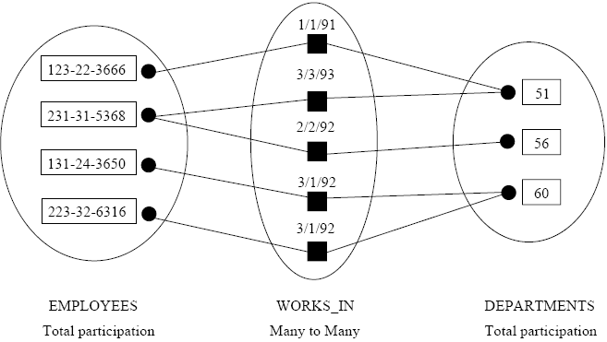
An Instance of the Works_In Relationship Set

Slide 12
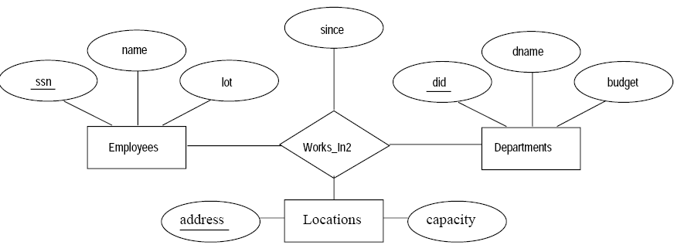
A Ternary Relationship Set:
Works_In2

Slide 13
ER Model Basics (Cont.)
name
ssn
lot
Employees
since
dname
super-visor
subor-dinate
did
budget
Reports_To
Departments
Works_In
    Same entity set can participate in different relationship sets, or in different “roles” in the same relationship set.
Notes:
4

Slide 14
Key Constraints
since
name
dname
ssn
lot
did
budget
Manages
An employee can work in many departments;
a dept can have many employees.
Employees
Departments
Works_In
since
In contrast, each dept has at most one manager, according to the key constraint on Manages.
M-to-N
1-to-1
1-to-N
Notes:
6

Slide 15
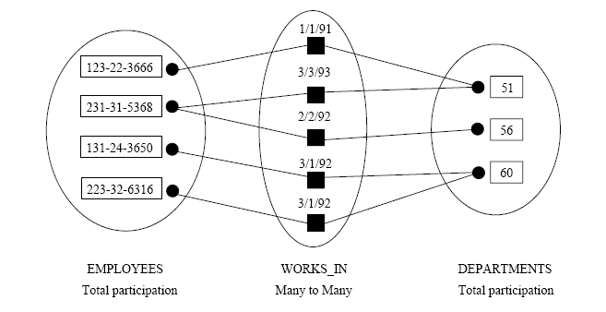
An Instance of the Manages Relationship Set
MANAGES is a kind of WORKS_IN
violates the key constraint on MANAGES:
A dept has at most one manager.

Slide 16
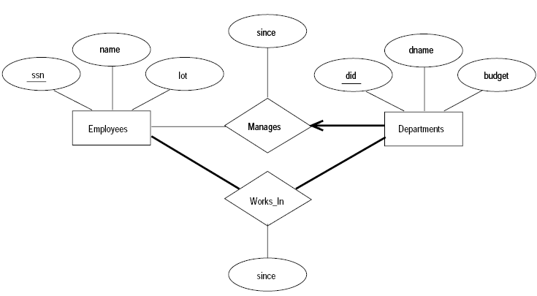
Participation Constraints
The participation of the entity set Departments in the relationship set Manages is said to be total if we assume every department have a manager.
  Connect Departments and Manages by a thick line.
The participation of the entity set Employees in Manages is partial.

Slide 17
Weak Entities
A weak entity can be identified uniquely only by relationship with of another (owner) entity.
  Owner entity set and weak entity set must participate in a 1-N relationship set (1 owner, N weak entities).
  Weak entity set must have total participation in this identifying relationship set.
name
ssn
lot
cost
pname
age
Employees
Policy
Dependents
Weak entities have only a “partial key” (dashed underline)
Notes:
10

Slide 18
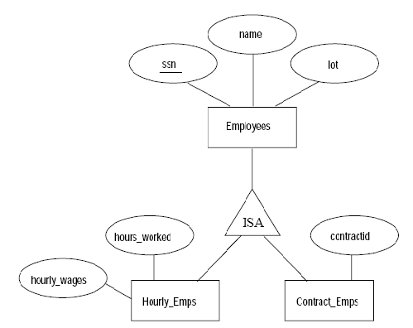
Class Hierarchies:
Organizing Entities into ISA (`is a’) Hierarchies
Overlap constraints:
Can Joe be an Hourly_Emps as well as a Contract_Emps entity? (Allowed / disallowed)
Covering constraints:
Does every Employees entity also have to be an Hourly_Emps or a Contract_Emps entity?(Yes / no)

Slide 19
Aggregation
As defined so far, a relationship set is an association between entity sets.
Aggregation allows us to model a relationship set between entities and relationships.
  i.e., treat a relationship set as an entity set for purposes of participation in (other) relationships.

Slide 20
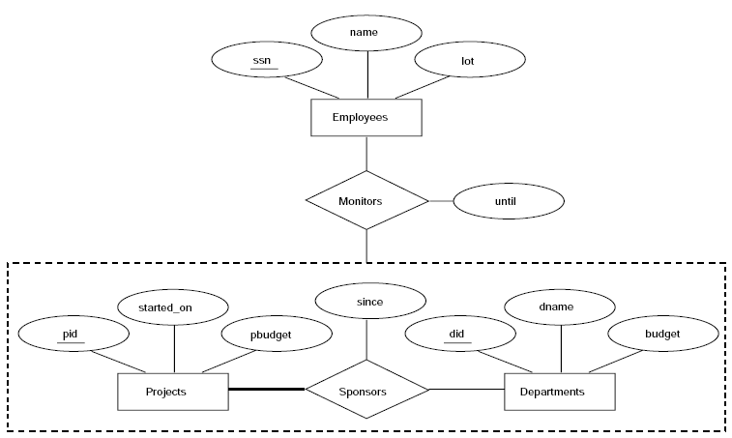
An Example of Aggregation
A department may assign employees to monitor a sponsorship.
A project is sponsored by at least 1 department.
Monitors is a relationship between entity Employees and relationship Sponsors.

Slide 21
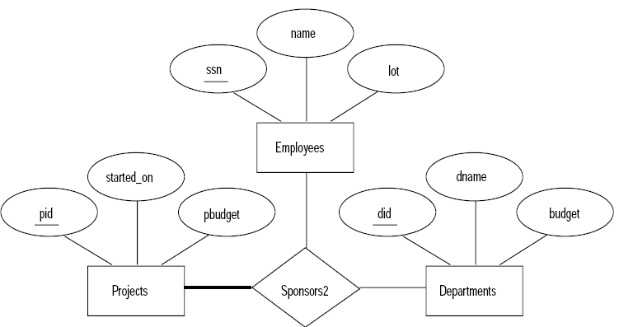
Aggregation vs. Ternary Relationship
Here, the Monitors relationship is not clearly expressed.
Some attributes are not easily expressed without aggregation, such as “until”.

Slide 22
Conceptual Design Using the ER Model
ER modeling can get tricky!
Design choices:
  Entity or attribute?
  Entity or relationship?
  Relationships: Binary or ternary? Aggregation?
ER Model goals and limitations:
  Lots of semantics can (and should) be captured.
  Some constraints cannot be captured in ER.
    We’ll refine things in our logical (relational) design

Slide 23
Entity vs. Attribute
“Address”:
  attribute of Employees?
  Entity of its own?
It depends! Semantics and usage.
  Several addresses per employee?
    must be an entity
    atomic attribute types (no set-valued attributes!)
  Care about structure? (city, street, etc.)
    must be an entity!
    atomic attribute types (no tuple-valued attributes!)

Slide 24
Entity vs. Relationship
Separate discretionary budget (dbudget) for each dept.
What if manager’s dbudget is a SUM that covers all managed depts
  Could repeat value
Better design:
  Associate dbudget with the appointment of the employee as manager of a group of depts.
since
dbudget
name
dname
ssn
lot
did
budget
Employees
Manages2
Departments
name
ssn
lot
dname
Employees
did
budget
Departments
is_manager
managed_by
since
apptnum
Mgr_Appts
dbudget
Notes:
6

Slide 25
Summary of the ER Model
Entities and Entity Set (boxes)
Relationships and Relationship sets (diamonds)
  binary
  n-ary
Key constraints (1-1,1-N, M-N, arrows)
Participation constraints (bold for Total)
Weak entities - require strong entity for key

